Slide 1
Hashing

Slide 2
Hashing
Hashing is a searching technique which is independent of number n.
We assume that there is a file F of n records with a set K of keys which uniquely determine the records in F.
We assume that F is maintained in memory by a table T of m memory locations and that L is the set of memory addresses of the locations in T.
We introduce a function H from the set K of keys into the set L of memory addresses:
H : K -> L
This mapping is called hashing.

Slide 3
The hash function calculation has two main criteria:-
The function H should be quick and easy to compute.
It should uniformly distribute the hash addresses throughout the set L so that there are minimum number of collisions.

Slide 4
Example
Hash
Table
0
1
Items
Hash
Function
2
john 25000
3
john 25000
phil 31250
key
4
phil 31250
dave 27500
5
mary 28200
6
dave 27500
7
mary 28200
key
8
9

Slide 5
Hash function
Problems:
Keys may not be numeric.
Number of possible keys is much larger than the space available in table.
Different keys may map into same location
  Hash function is not one-to-one => collision.
  If there are too many collisions, the performance of the hash table will suffer dramatically.

Slide 6
Hash Functions
Division Method
Choose a number m close to the number of keys in K(Usually m is taken as prime number). The hash function H is defined by
H(k) = k (mod m) or H(k) = k (mod m) +1
Where k (mod m) denotes the remainder when k is divided by m. The second formula is used when we want hash addresses to range from 1 to m rather than from 0 to m-1.

Slide 7
Midsquare method
The key k is squared. Then the hash function H is defined by
H(k) = p
Where p is obtained by deleting digits from both ends of k²

Slide 8
Folding Method
The key k is partitioned into number of parts k_{1,} k_{2,……..,} k_{r} where each part, except the last, has the same number of digits as the required address. Then the parts are added together, ignoring the last carry. That is
H(k) = k₁ + k₂ + ……..+ k_{r}
Where the leading-digit carries, if any, are ignored. Sometimes, the even numbered parts are each reversed before the addition.

Slide 9
Collision Resolution
If, when an element is inserted, it hashes to the same value as an already inserted element, then we have a collision and need to resolve it.
There are several methods for dealing with this:
  Separate chaining
  Open addressing
    Linear Probing

Slide 10
Separate Chaining
The idea is to keep a list of all elements that hash to the same value.
  The array elements are pointers to the first nodes of the lists.
  A new item is inserted to the front of the list.
Advantages:
  Better space utilization for large items.
  Simple collision handling: searching linked list.
  Overflow: we can store more items than the hash table size.
  Deletion is quick and easy: deletion from the linked list.

Slide 11
Example
Keys: 0, 1, 4, 9, 16, 25, 36, 49, 64, 81
hash(key) = key % 10.
0
0
1
81
1
2
3
4
64
4
5
25
6
36
16
7
8
9
49
9

Slide 12
Hashing: Open Addressing

Slide 13
Collision Resolution with
Open Addressing
Separate chaining has the disadvantage of using linked lists.
  Requires the implementation of a second data structure.
In an open addressing hashing system, all the data go inside the table.
  If a collision occurs, alternative cells are tried until an empty cell is found.

Slide 14
Open Addressing
More formally:
  Cells h₀(x), h₁(x), h₂(x), …are tried in succession where h_{i}(x) = (hash(x) + f(i)) mod TableSize, with f(0) = 0.
  The function f is the collision resolution strategy.
The most common collision resolution strategy in open addressing is :
  Linear Probing

Slide 15
Linear Probing
In linear probing, collisions are resolved by sequentially scanning an array (with wraparound) until an empty cell is found.
  i.e. f is a linear function of i, typically f(i)= i.
Example:
  Insert items with keys: 89, 18, 49, 58, 9 into an empty hash table.
  Table size is 10.
  Hash function is hash(x) = x mod 10.
    f(i) = i;

Slide 16
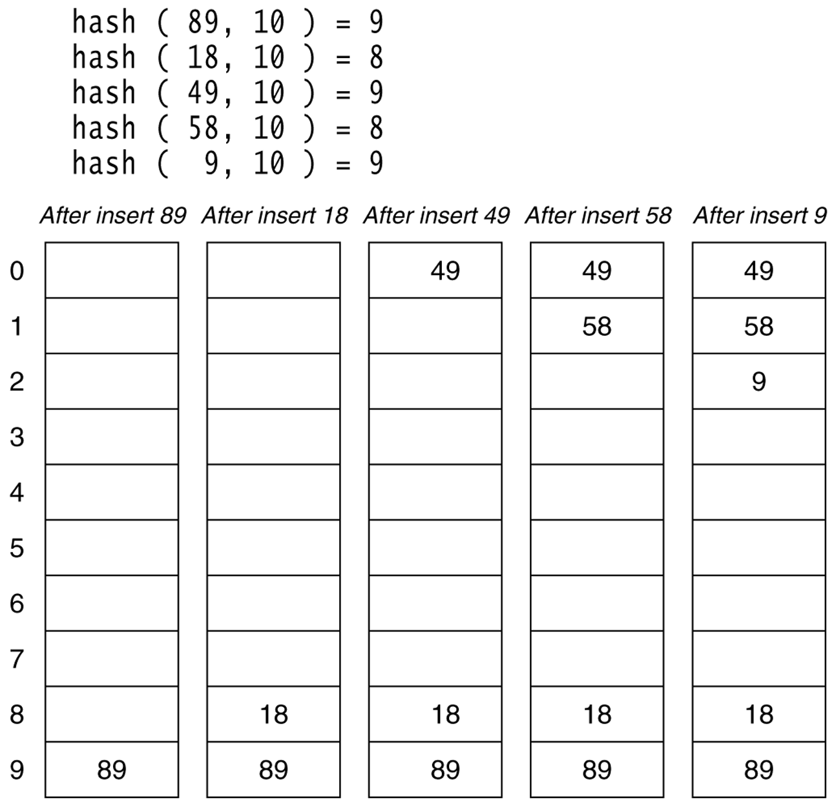
Figure 20.4
Linear probing hash table after each insertion

Slide 20
What is a hash table?
a) A structure that maps values to keys
b) A structure that maps keys to values
c) A structure used for storage
d) A structure used to implement stack and queue

Slide 21
If several elements are competing for the same bucket in the hash table, what is it called?
a) Diffusion
b) Replication
c) Collision
d) Duplication

Slide 22
What is direct addressing?
a) Distinct array position for every possible key
b) Fewer array positions than keys
c) Fewer keys than array positions
d) Same array position for all keys

Slide 23
What is simple uniform hashing?
a) Every element has equal probability of hashing into any of the slots
b) A weighted probabilistic method is used to hash elements into the slots
c) Elements has Random probability of hashing into array slots
d) Elements are hashed based on priority

Slide 24
The process of examining the free slot is called___
Hashing
Probing

